Slide 1
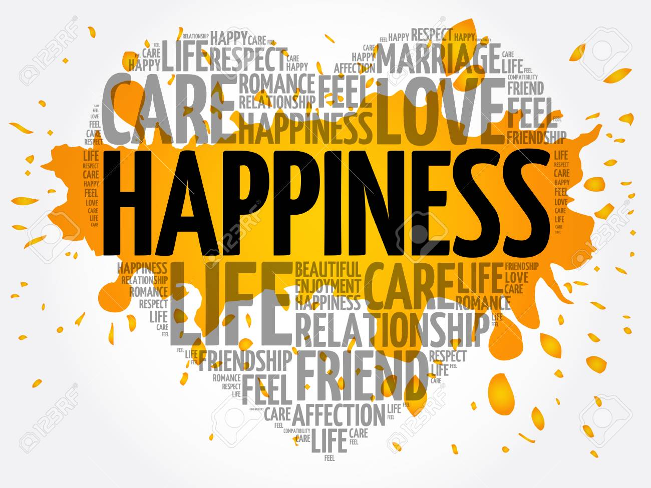
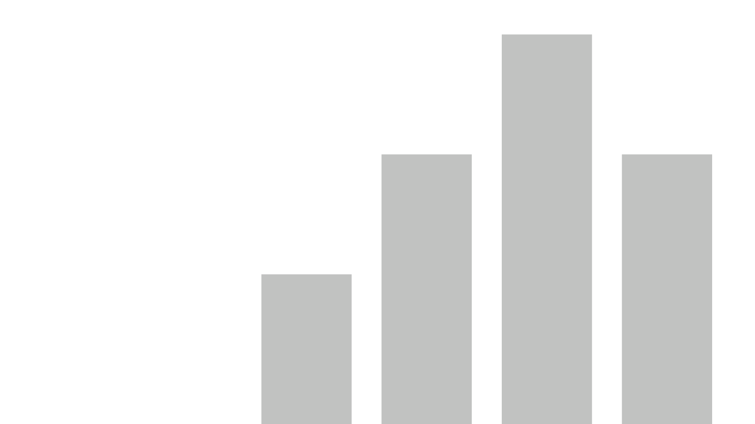
Executive Presentation for Capstone One
Last data refresh:
9/29/2020 9:22:58 PM Eastern Standard Time
Downloaded at:
10/10/2020 8:50:45 PM Eastern Standard Time

Slide 2

What is Happiness?
According to Sonja Lyubomirsky, happiness is “the experience of joy, contentment, or positive well-being, combined with a sense that one’s life is good, meaningful, and worthwhile.”

Slide 3
Global Happiness Index
Data Source: Kaggle
Date Range: 2015
Dataset has seven variables as follows:
Happiness score (1-10)
GDP_Per_Capita (0-2)
Social Support (0-2)
Generosity (0-1)
Freedom (0-1)
Health (0-2)
Government Trust (0-1)

Slide 4

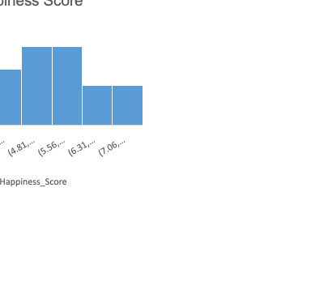

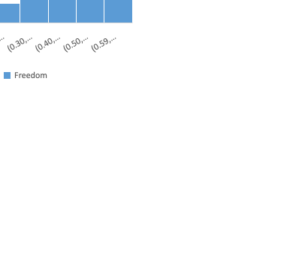
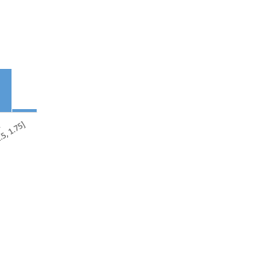

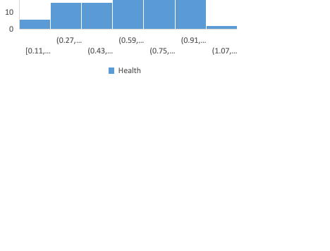
Descriptive Statistics: Shape of the following seven variables.

Slide 5
Descriptive Statistics: Finland has been found to be the most happiest country with the overall happiness score of 7.81 while Afghanistan has been found to be the least happiest country with the score of only 2.57.

Slide 6
Correlation analyses across datasets yield particularly interesting insights by showing all of the variables significantly positively correlated except Generosity (r = 0.08) which is found to be statistically non-significant with Happiness score.

Slide 7
Lastly, using inferential statistics, analysis of the statistical significance of variables contributing towards Happiness score reveal that with a R Squared of 0.746, a linear model is a good fit for the data to understand the individual Happiness score of the countries.
Note: The above analysis utilized p < 0.05 as a statistical significance.

